Slide 1

Motion Based Message Conveyer For Disabled People
Team Members:
D. Tharun Kumar 19PA1A0440
G. Raj Prakash 19PA1A0456
B. Ganesh 20PA5A0403
Ch. Manju Nadha Reddy 19PA1A0422
G. Joshua 19PA1A0448
Under the Esteemed guidance of
Mrs. D. Manaswi,
Assistant Professor
Department of ECE
Department of Electronics and Communication Engineering
VISHNU INSTITUTE OF TECHNOLOGY(A), BHIMAVARAM
(Approved by AICTE, Permanently affiliated to JNTUK, Accredited by NBA & NAAC)
20-09-2021

Slide 2
CONTENTS
Introduction
Components Required
Methodology
Results
Conclusion
References

Slide 3


PROBLEM
INTRODUCTION
What do paralytic (or) disabled people do to convey the messages (or) call helper (or) nurse ?

Slide 4

SOLUTION
We propose a simple yet effective way to solve this age old problem. The main purpose is to replace the conventional approach of patient-nurse communication with modern technologies that provide a much faster and reliable way to do so.

Slide 5
ABSTRACT
The main aim of the project is to implement a low cost reliable system which will help to establish communication between paralytic or disabled patients and a nurse. A patient can easily send messages to the nurse by just tilting an accelerometer connected to a body part capable of movement.

Slide 6
COMPONENTS REQUIRED
Arduino Nano
LCD Display
Accelometer Sensor
Potentiometer
Buzzer
Power Supply
Bread Board
Jumper Wires

Slide 7
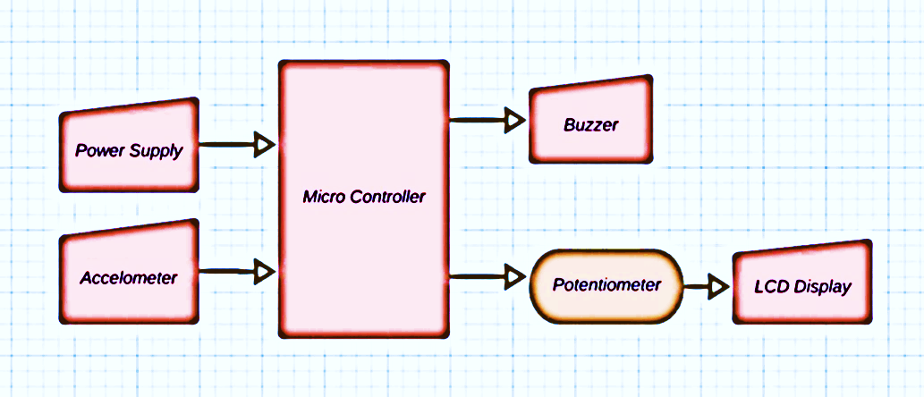
METHODOLOGY
BLOCK DIAGRAM

Slide 8
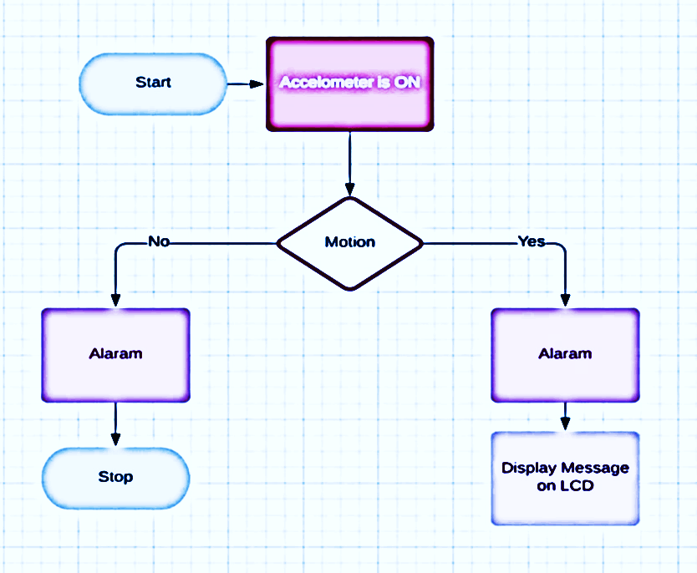
PROCESS

Slide 9
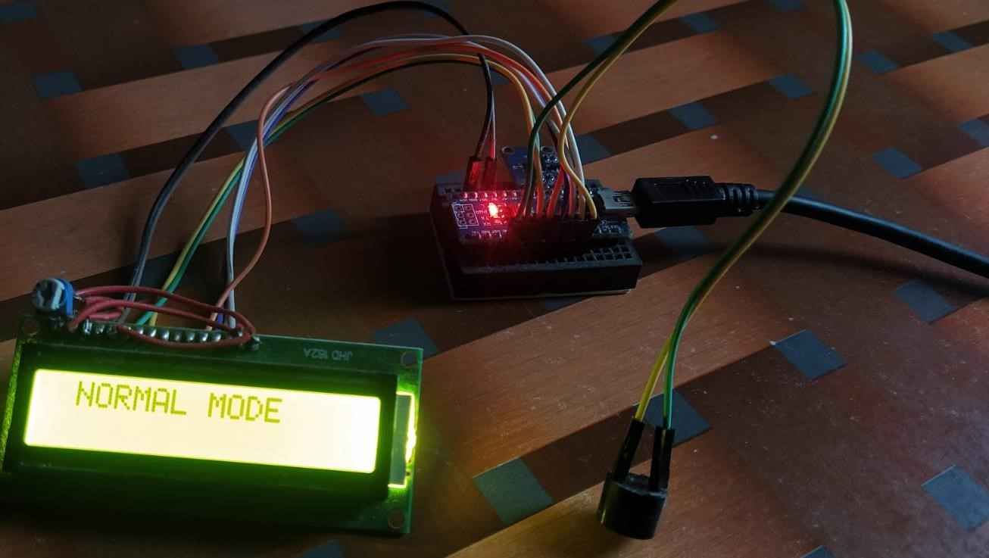
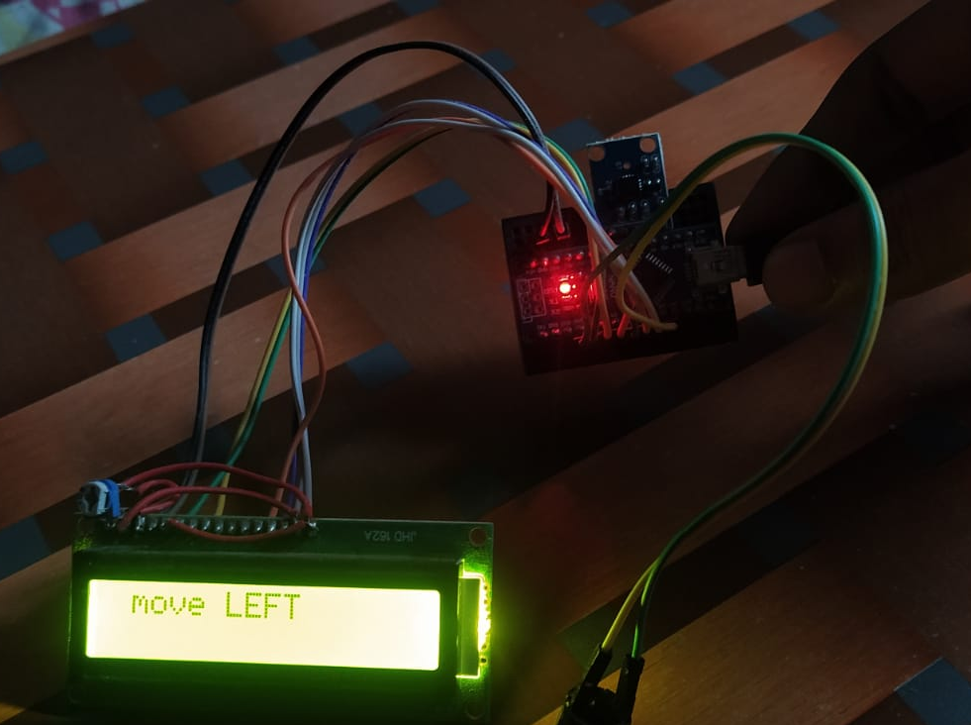
RESULTS
Fig(a). Message when at rest
Fig(b). Message when tilted in left direction

Slide 10
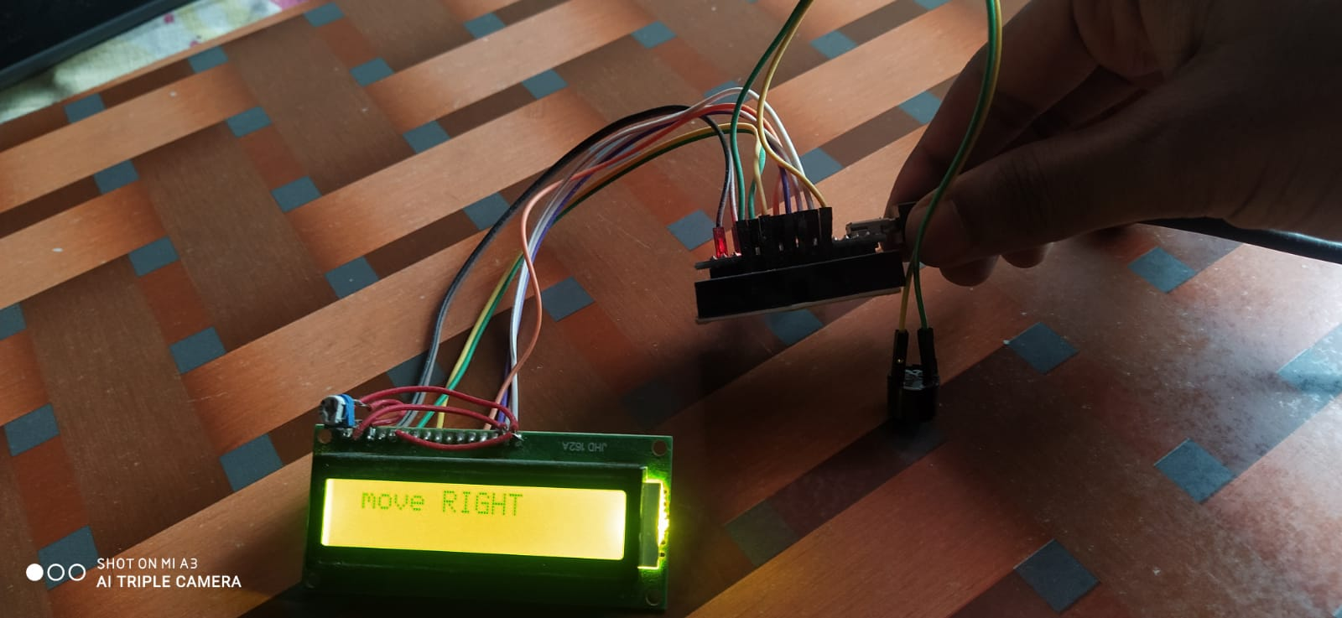
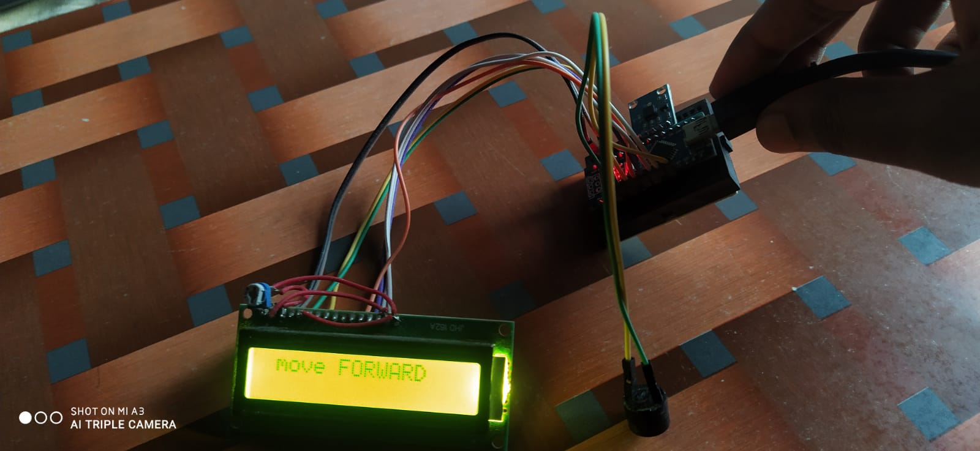
Fig(c). Message when tilted in right direction
Fig(d). Message when tilted in upward direction

Slide 11
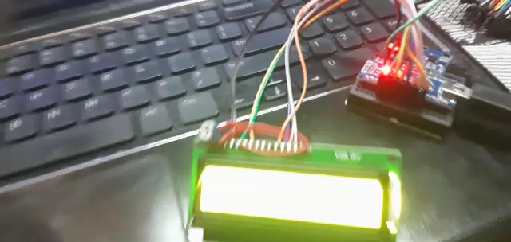
Working Video
https://youtu.be/xFOs4pSL57Y
Video Link:

Slide 12
CONCLUSION
This device has made conveyance of message possible only by the motion of a body part. The ease of message conveyance is the main advantage of this system along with the real time user defined medicine alarm. The prototype we have made is fully functional but restricted to a small area of operation. For a large area and transmission distance the type of communication used have to be more effective and faster. Our system successfully proves that this system is an excellent approach to be implemented at hospitals for patient-nurse communication. The project can be further developed into an automatic wheel chair wherein the wheelchair will be moved just by hand gesture. Also, along with only message transmission other data like body temperature, pulse rate etc. can also be transmitted to the nurse so that a real time record of all the patients is maintained.

Slide 13

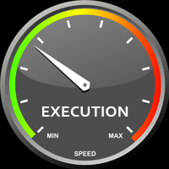
ADVANTAGE
Portable Device
Affordable Price
Faster Response

Slide 14
REFERENCES
RuizeXu, Shengli Zhou, and Wen J. Li, Fellow, IEEE, “MEMS Accelerometer Based
Nonspecific-User Hand Gesture Recognition”, IEEE SENSORS JOURNAL,
VOL. 12, NO. 5, MAY 2012.
Amarjot Singh, Devinder Kumar et.al “An Intelligent Multi-Gesture Spotting Robot to Assist Persons with Disabilities”.
Shreedeep Gangopadhyay, Somsubhra Mukherjee, Soumya Chatterjee, “Intelligent gesture controlled wireless wheel chair for the physically handicapped”, Proceedings of Fifth IRAJ International Conference, 15th September 2013, Pune, India.

Slide 15


